Slide 1
INDOOR NAVIGATION SYSTEM
Clyde Noronha
Mustafa Zaki
Shane Gracias
Ruman Mulla

Slide 2
LITERATURE
SURVEY

Slide 3
Robust Indoor Positioning Provided by Real-Time RSSI Values in Unmodified WLAN Networks - Mazuelas et al (2009), IEEE
Task | Methodology | Datasets | Results | Limitations | Conclusions
Indoor Positioning by using RSS WLAN networks. | Includes. calibration stage and the second, MS position is determined based on comparison between stored values and real time values. | Stored RSS values | The proposed method has mean error of a little less 4m (3.97m). | Depends on the propagation environment present between MS and each Access Point. | The accuracy is not good compared to the complexity and time required to compare the values in the offline stage.

Slide 4
AMID: Accurate Magnetic Indoor Localization Using
Deep Learning - Lee et al (2018), sensors
Task | Methodology | Datasets | Results | Limitations | Conclusions
Indoor Positioning by classification of magnetic sequences by a deep neural network to get magnetic landmarks. | Data is collected, classification model is created and location is estimated based on surrounding magnetic landmarks. | Magnetic sensor data that is preprocessed to gain magnetic fingerprint data. | Tested in corridor and atrium. Positioning error (corridor) = 0.76m Positioning error (atrium) = 2.30m | Amount of unique fingerprints is large. Pattern detection will require a lot of computation. | Accuracy is good, but complexity of DNN coupled with large amount of data is a disadvantage.

Slide 5
Objective
Indoor Positioning using sophisticated deep learning algorithm - Long Short Term Memory (LSTM).

Slide 6
Introduction
We propose a novel approach for indoor positioning using deep learning algorithm based on Long Short Term Memory . LSTM provides a significant improve over the following approaches:
RSS of WiFi and Bluetooth
Geomagnetic FIngerprinting
Diffuse Infrared LEDs
Sound
Computer Vision

Slide 7
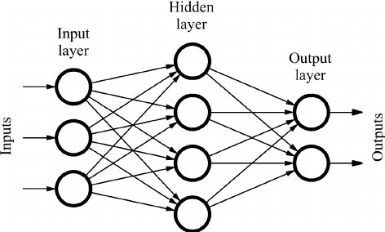

Recurrent Neural Networks
Conventional Feed Forward Network
The connections between the input nodes and output nodes do not form a cycle.
Recurrent Neural Networks
The output of the previous RNN is given as the input to the next RNN along with the main input.

Slide 8
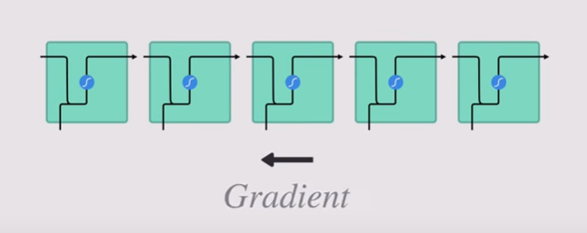
Limitation of RNN
Vanishing & Exploding Gradient Problem
New Weight = Weight - Learning Rate * Gradient
2.0999 = 2.1 - 0.001
If the weight is <<1 and is used to train, the corresponding hidden states will keep decreasing till 0, which makes the input meaningless.
If the weight is >>1 and is used to train, the hidden states will keep increasing till infinity, which also makes the input meaningless.

Slide 9
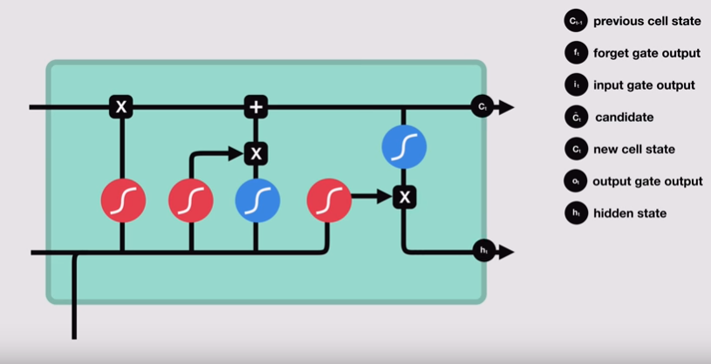
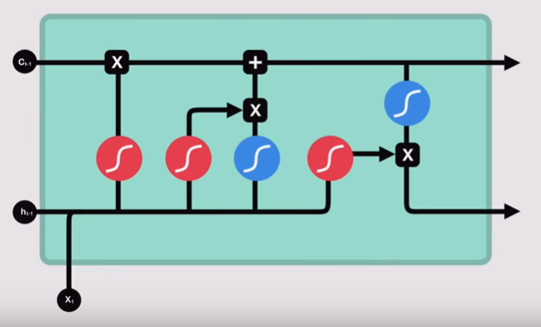
Long Short Term Memory (LSTM)

Slide 10
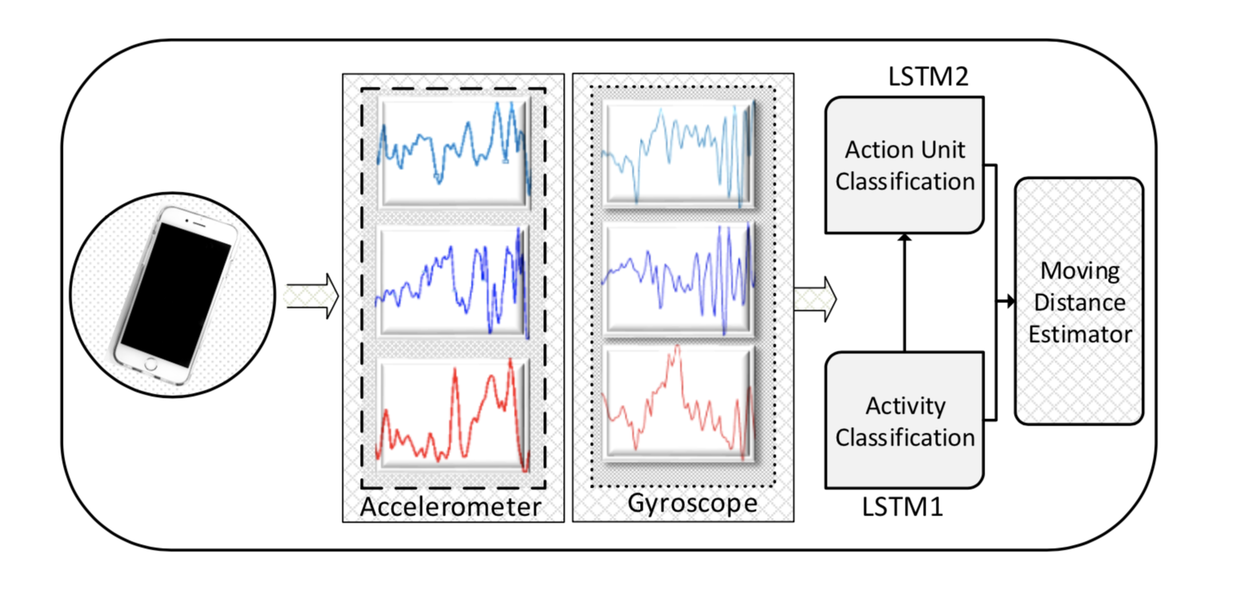
Architecture
Collection of data from the inertial sensors -Accelerometer (Body acceleration) -Gyroscope (Angular acceleration)
Classification of Data -Action unit classification -Activity classification
Estimating the trajectory of the user.

Slide 11
Collection of Data
In this step raw data is collected from the inertial sensors (Accelerometer and Gyroscope). The dataset is stored into 2 sets, {ax,ay,az} and {gx,gy,gz}.
ax,ay,az are accelerometer values of x-axis,y-axis and z-axis respectively. gx,gy,gz are gyroscope values of x-axis,y-axis and z-axis respectively.
The average of these datasets are taken in order to remove the noise and the outliers. After filtering the high frequency noises, the 3 axis filtered acceleration and gyroscope signals are grouped together. These form the training dataset for the proposed LSTM.

Slide 12
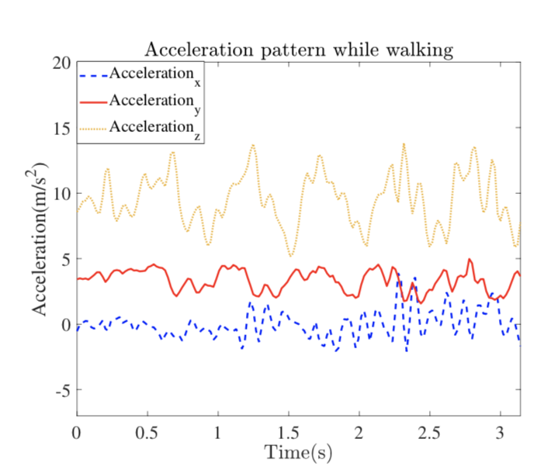
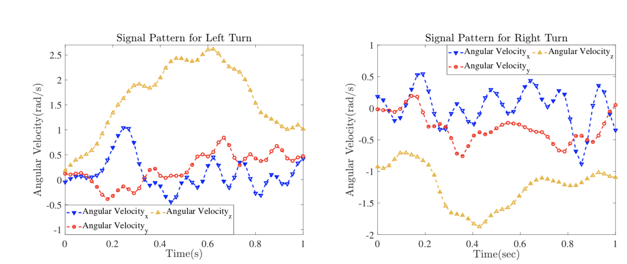
Gyroscope and Accelerometer readings

Slide 13
Classification
The Classification stage consists of two main parts
Activity Classification The recorded signal is classified into 3 motion states - Walking - Running - Stopping
Action Unit classification The motion states are further classified into 7 Action Units (AUs) - Short Step (54.2cm) - Long Step (107.75cm) - Normal Step (70cm) - Left Turn - Right Turn - Stopping - Abnormal Activity

Slide 14
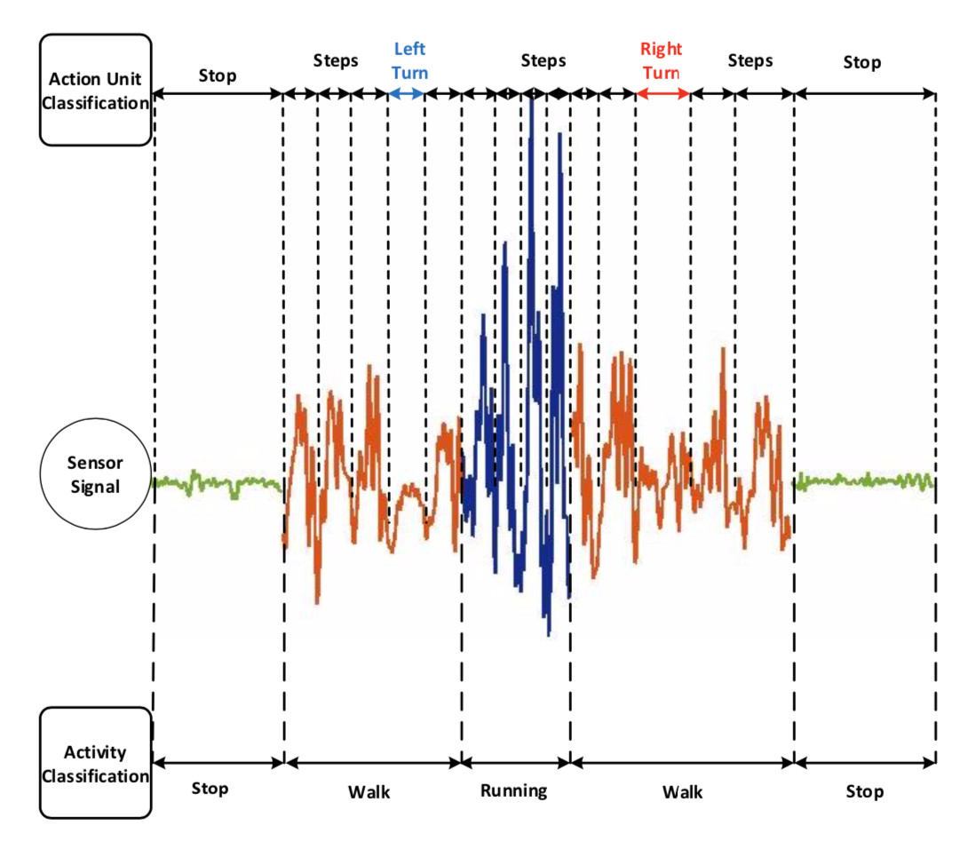

Slide 15
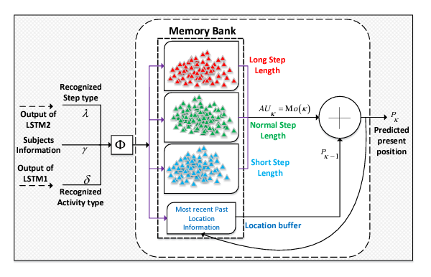
Estimation
After the recognition of the classification from the 2 LSTMs, the output of these LSTMs is fed into the distance estimator which estimates the present position of the user from the pre-collected pool of data. The inputs to the distance estimator are: - Output of LSTM 1 and LSTM 2 - Subject information
The estimator consists of the memory bank which is divided into clusters of different step lengths (Long Step, Normal Step, Short Step) and values from the most recent location is stored in location buffer. The distance estimator updates the previously stored position stored in the location buffer by adding recently recognised AU to it. P = position
Pk = Pk-1 + AUk

Slide 16
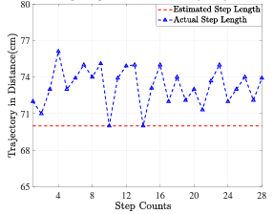
Datasets & Results
Datasets The data was divided into 2 portions: Training (75%) and Test (25%) - The number of training and test instances for the activities were 1566 and 522 respectively. - The training and test instances for AU were 2781 and 927 respectively.
Results - The LSTM recognised the activities with an accuracy of 97.9% and the 7 Action Units with an accuracy of 95.5%. - The cumulative error for the proposed indoor navigation was 0.782 m

Slide 17
References
Robust Indoor Positioning Provided by Real-Time RSSI Values in Unmodified WLAN Networks - Santiago Mazuelas et al. (2009)
AMID: Accurate Magnetic Indoor Localization Using Deep Learning - Namkyoung Lee, Sumin Ahn and Dongsoo Han (2018)
Indoor Positioning System: A New Approach Based on LSTM and Two Stage Activity Classification GhulamHussain , Muhammad Shahid Jabbar, Jun-Dong Cho and Sangmin Bae (2019)
http://www.wildml.com/2015/10/recurrent-neural-network-tutorial-part-4-implementing-a-grulstm-rnn-with-python-and-theano/

